Slide 1
Final Report
Mastering a zero-sum asymmetric game using deep neural networks
Eliav Shalelashvili

Slide 2
Table of contents
The Problem of Light Against Zombies
Framework Implementation
Learning Agents
Game Scenarios and Evaluations
The Competition Between Learning Agents
Conclusions

Slide 3
Research goal
Build learning agents to master the game of Light against Zombies
Notes:
בניית שחקנים לומדים במשחק האור והזומבים

Slide 4
The Game - light against zombies

Slide 5
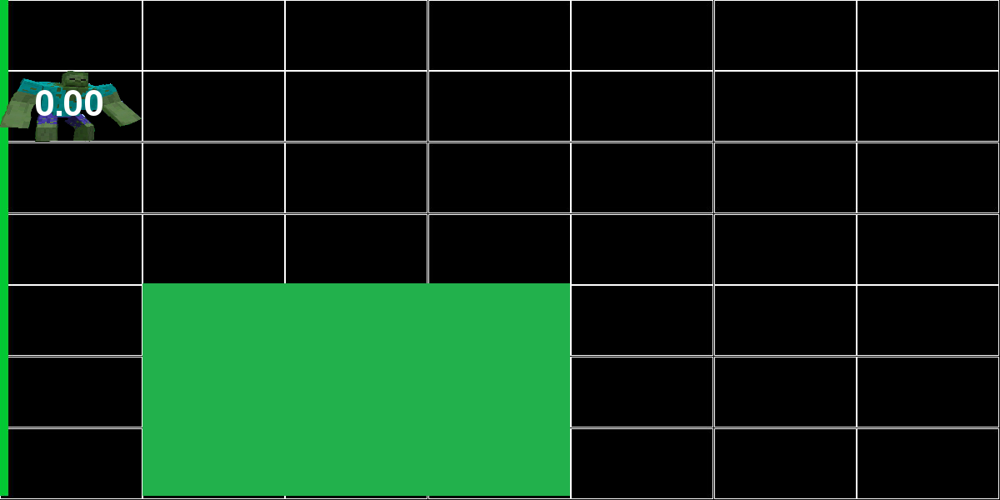
Example – 1st frame
Zombie reward: 0
Light reward: 0
Notes:
Light size of 3x3
Zombie chose 2nd row
Light chose 5th row, 2nd column

Slide 6
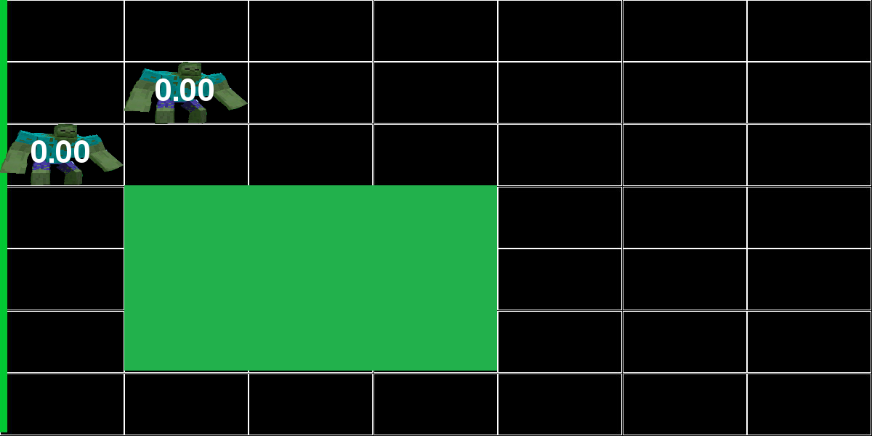
Example – second frame of the game
Zombie reward: 0
Light reward: 0
Notes:
Zombie chose 3rd row
Light chose 4th row, 2nd column

Slide 7
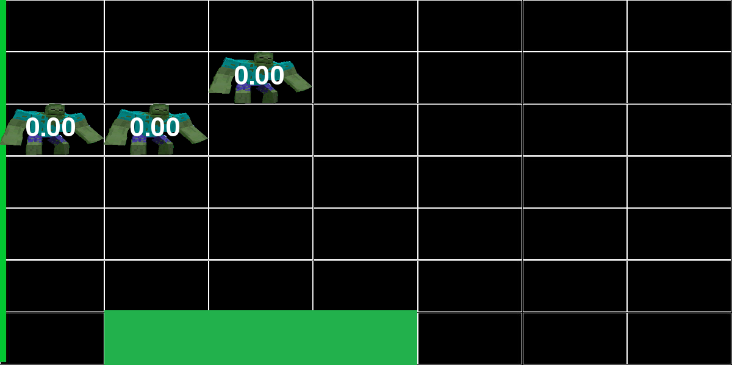
Example – third frame of the game
Zombie reward: 0
Light reward: 0
Notes:
Zombie chose 3rd row
Light chose 7th row, 2nd column

Slide 8


Light Against zombies
Board of $N×N$ cells
Action space
Zombie Player – starting position* for a new zombie, total of $N$ possible actions
Light Player - light position on the board, total of $N×N$ possible actions
State space
Zombie Player - zombies’ positions
Light Player - zombies’ positions and hit points

Slide 9

Environment characteristics
Reward function
Opposite reward
Zombies that go over the right boundary, provide reward of 0 or 1 and disappear
The reward is calculated based on the number of hits: $U=\sqrt[3]{hit_points}$
Values greater than 1 mean that the zombie is destroyed thus provides no reward
For the rest of the zombies (values in range $\left[0,1\right]$) we decide whether they are killed based on the Bernoulli distribution with parameter $U$

Slide 10
Example – 1st frame
Zombie reward: 0
Light reward: 0
Notes:
Light size of 3x3
Zombie chose 2nd row
Light chose 5th row, 2nd column

Slide 11
Example – second frame of the game
Zombie reward: 0
Light reward: 0
Notes:
Zombie chose 3rd row
Light chose 4th row, 2nd column

Slide 12
Example – third frame of the game
Zombie reward: 0
Light reward: 0
Notes:
Zombie chose 3rd row
Light chose 7th row, 2nd column

Slide 13
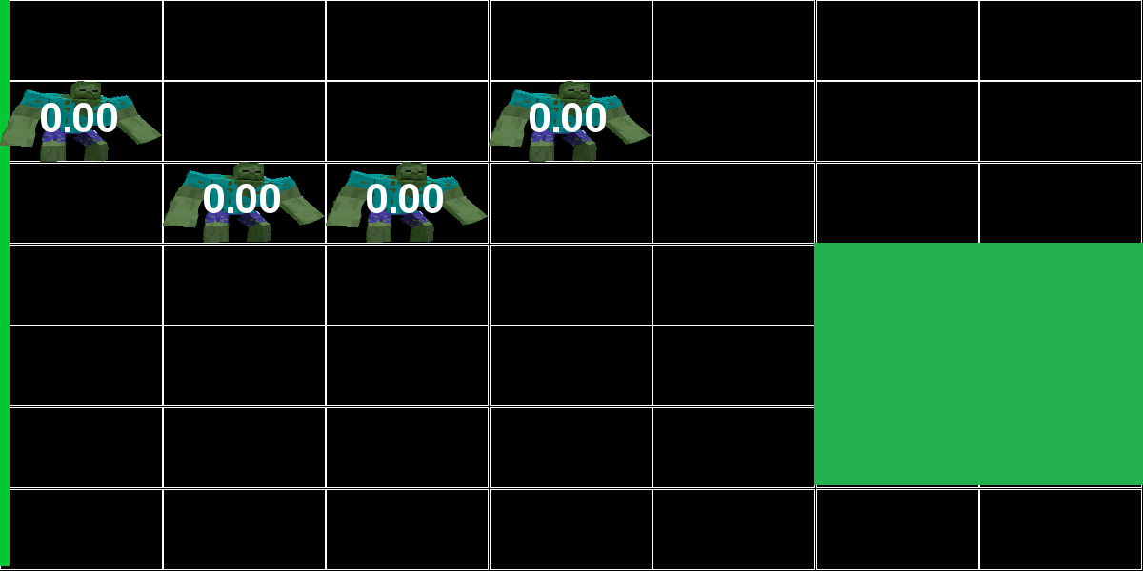
Example – forth frame of the game
Zombie reward: 0
Light reward: 0

Slide 14
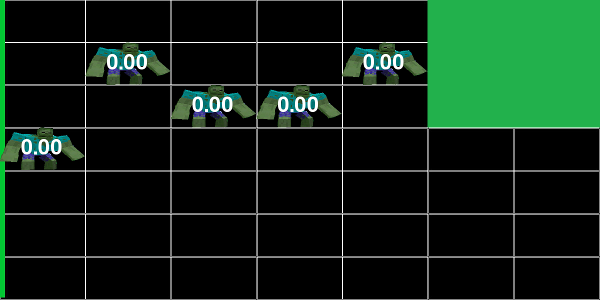
Example – fifth frame of the game
Zombie reward: 0
Light reward: 0

Slide 15
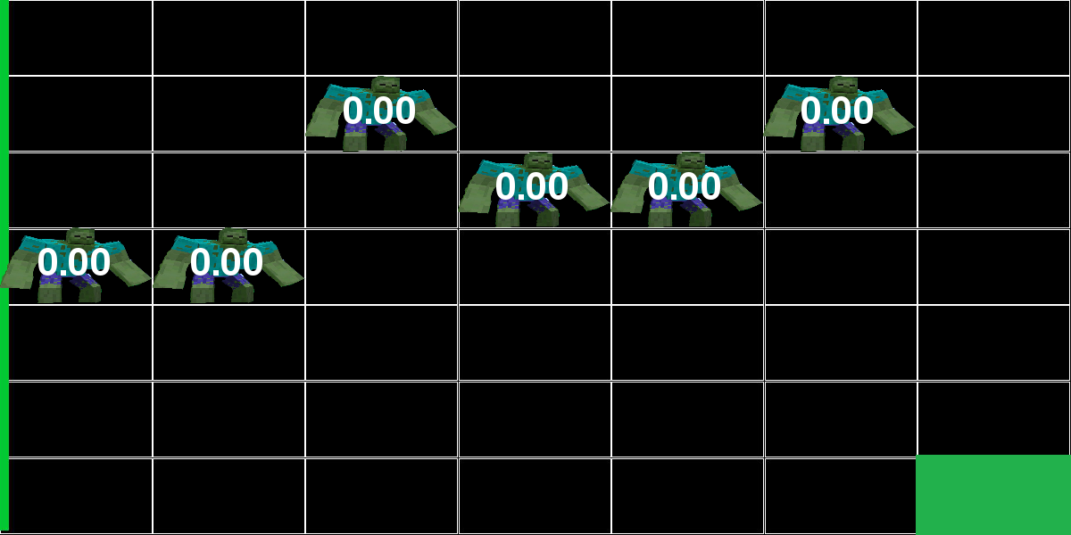
Example – sixth frame of the game
Zombie reward: 0
Light reward: 0

Slide 16
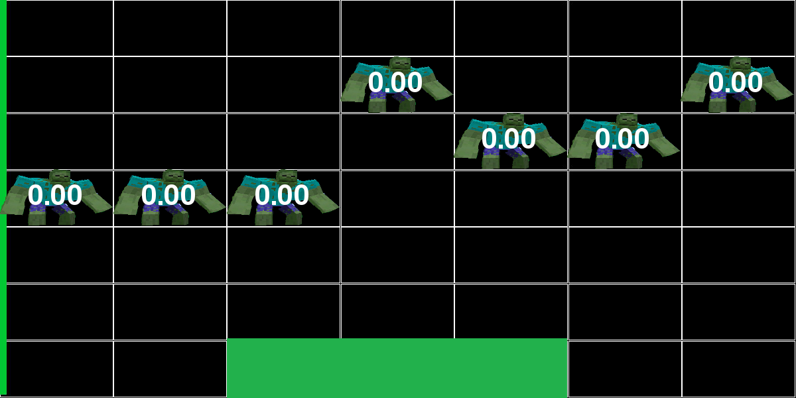
Example – 7th frame
Zombie reward: 0
Light reward: 0

Slide 17
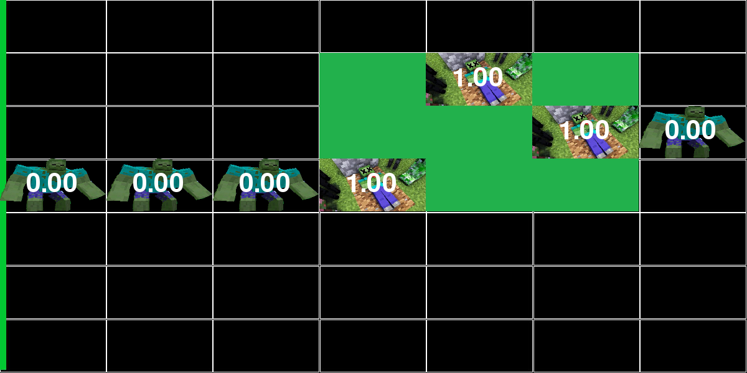
Example – 8th frame
Zombie reward: 1
Light reward: -1

Slide 18
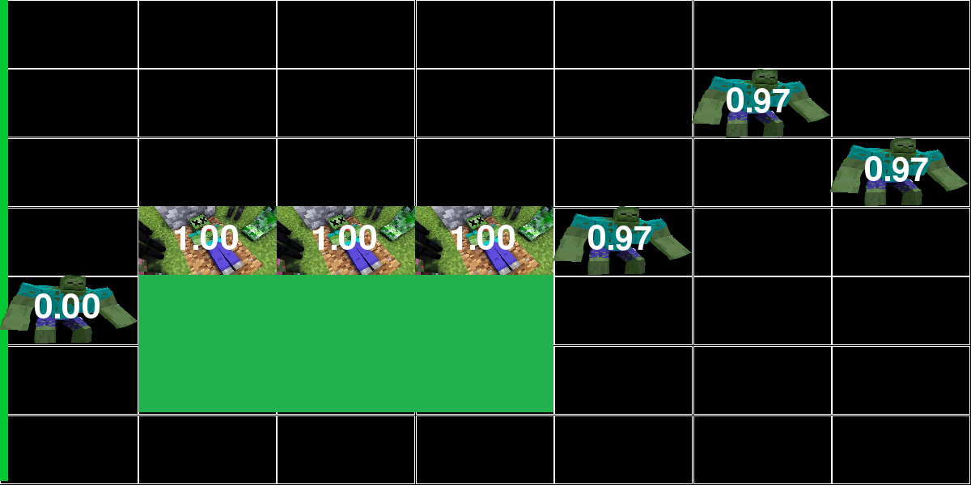
Example – 9th frame
Zombie reward: 1
Light reward: -1

Slide 19
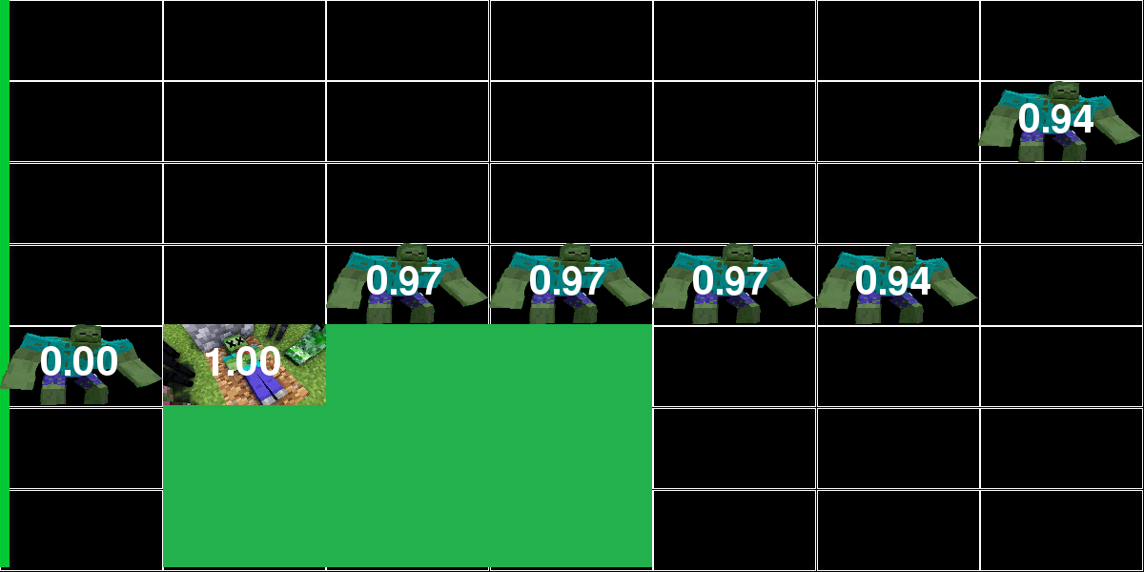
Example – 10th frame
Zombie reward: 0
Light reward: 0

Slide 20
Example – 11th frame
Zombie reward: 0
Light reward: 0

Slide 21
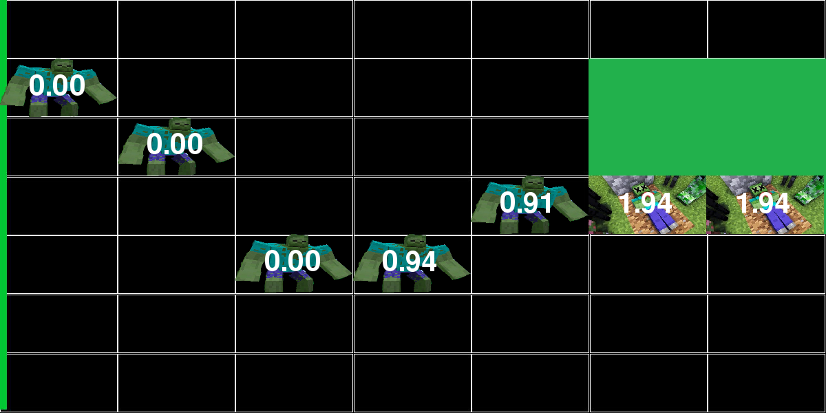
Example – 12th frame
Zombie reward: 0
Light reward: 0

Slide 22
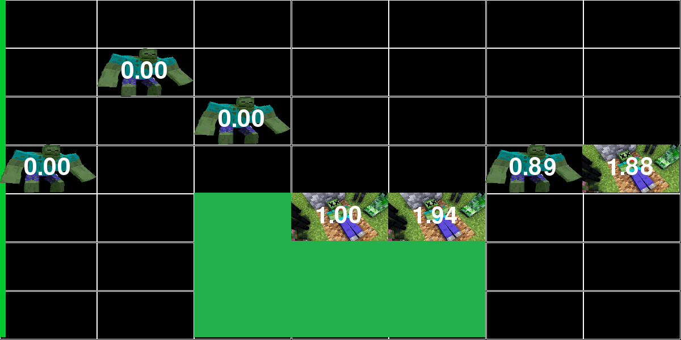
Example – 13th frame
Zombie reward: 0
Light reward: 0

Slide 23
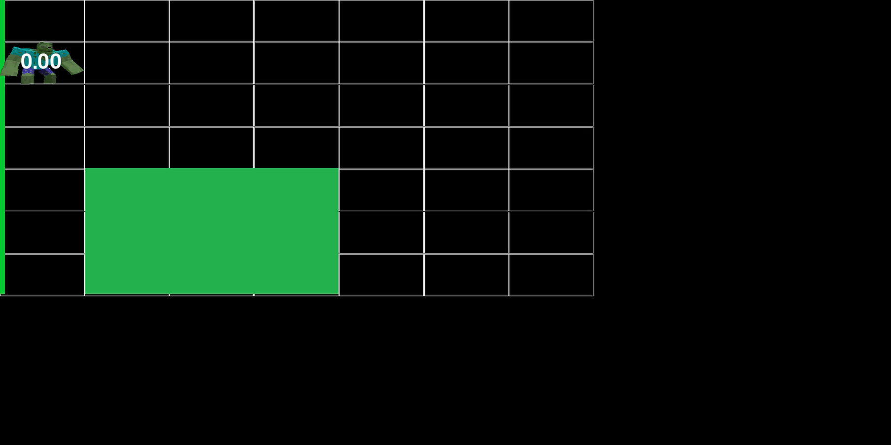
Game-play demonstration

Slide 24
Framework implementation
Building a framework that can communicate with an interface of generic type of any agent, turned to be an integrated and significant part of the project
We built a framework for developing and comparing reinforcement learning algorithms
More than 20 classes and interfaces
Four simple agents
A learning agent from the Reinforcement Learning domain
It currently contains the game of “Light against Zombie” and supports teaching agents as both players
Notes:
Before we diving deep into all the gameplay-scenarios, lets review the platform we have built to handle the project demands

Slide 25
running the framework
1. Define configuration:
Interactive mode - Boolean
Display width/height
Number of training and validation episodes
Number of zombies per episode
Light size
Board width/height
Maximum hit points
Heal ratio

Slide 26
running the framework
2. Competitors definition:
Each agent must implement some basic methods in order to participate the game:
Given a state, choose action
Learning by batches of (state, action, next state, reward)
Example:
Uniform distribution agent as the zombie player
Given a state, choosing action from uniform distribution
None
3. Run the scenario of two agents playing Light and Zombie

Slide 27
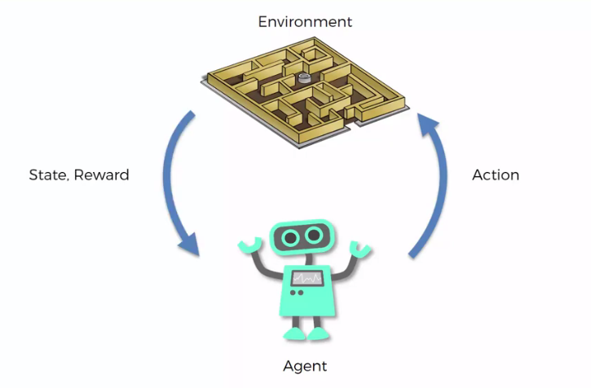


running the framework - summary
Preparations
1. Define agents and implement by abstract classes
2. Add configuration of agents and environment
Main Process
3. Run the game with two agents as light and zombie players
LIGHT
ZOMBIE

Slide 28

Games and agents
Squared Game Boards of $10, 20, 30$
Simple Agents:
Single Action
Double Action
Uniform
Gaussian
Learning Agent:
Double Deep Q-Learning
Monte Carlo Tree Search
Alpha Zero

Slide 29

Simple Agents elaboration
From a given set of N possible actions
Single Action - picks the first action
Double Action - picks the first and middle ($\frac{N}{2}$) actions
Uniform Action - picks a uniformly action
Gaussian Action - picks an action from the normal distribution with:
Mean - $\frac{N}{2}$
Standard deviation - $\frac{N}{5}$

Slide 30
Learning Agents Evaluation
DDQN, MCTS, Alpha-Zero

Slide 31
Double deep q-learning agent
Two networks:
Policy/online network
Target/offline network
At each learning step, backpropagate weights of online network with mean squared error loss of the target network

Slide 32

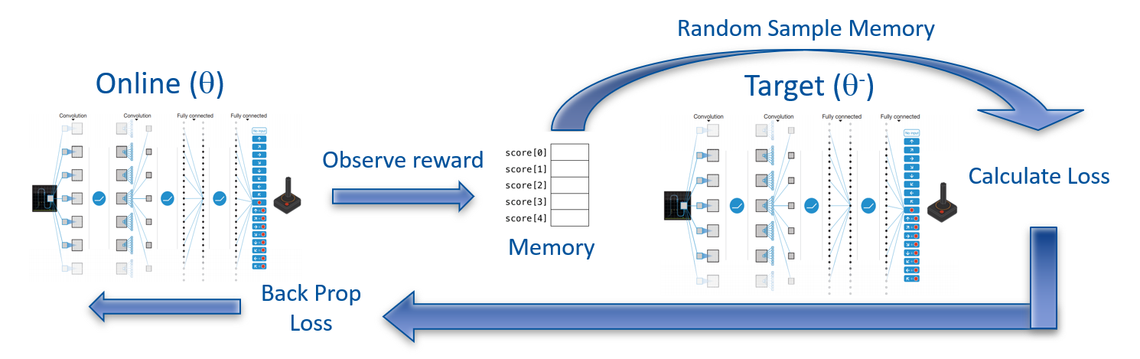
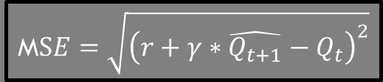


Game Environment
State
Double Deep Q-Learning Agent:
$${state}_{t+1}$$
$${state}_{t}$$
Back-prop
M$SE=\sqrt{{\left(r+γ∗\hat{Q_{t+1}}−Q_{t}\right)}^{2}}$
Loss
$$\hat{Q_{t+1}}= Target output$$
$$Q_{t}= Online output$$

Slide 33
Game config
Fixed Parameters:
Number of training episodes: 800
Number of test episodes: 200
Zombies per episode: 20
Light size: 2*
Minimum hit points of certain death: 1
Heal ratio: 0.97
Tuning Parameters:
Target Policy update frequency – [500, 750, 1000]
Replay Memory size – [3000, 4000, 5000]

Slide 34
game scenarios
Zombie Player | Light Player | Game Board
Single Action | DDQN | 10x10
Double Action
Uniform
Gaussian
Single Action | DDQN | 20x20
Double Action
Uniform
Gaussian
Single Action | DDQN | 30x30
Double Action
Uniform
Gaussian
Zombie Player | Light Player | Game Board
DDQN | Single Action | 10x10
 | Double Action
 | Uniform
 | Gaussian
DDQN | Single Action | 20x20
 | Double Action
 | Uniform
 | Gaussian
DDQN | Single Action | 30x30
 | Double Action
 | Uniform
 | Gaussian

Slide 35
Double deep q-learning evaluation process
1. Estimate success of the DDQN agent by Average Test Score
2. Choose the best sets of parameters
3. Compare the results of the best agents over different boards

Slide 36
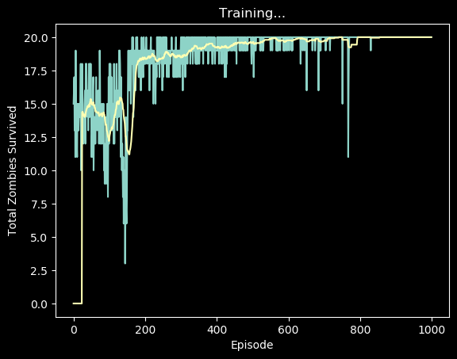
Example of a single evaluation
For each scenario (Ex. DDQN as Zombie and Single Action Agent as Light), the framework produces the following “Reward per episode” graph:

Slide 37

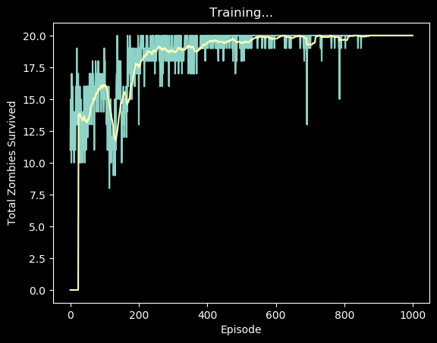


Example of a single evaluation
Considering the scenario of DDQN as Zombie vs. Single Action Agent as Light on top a board of $10×10$:
First, repeat the scenario several times
Second, get the average of test rewards
Average
$$−>$$
19.99

Slide 38
DDQN as the zombie player
Goal – Maximize Total Reward - Maximize Zombies Survive

Slide 39
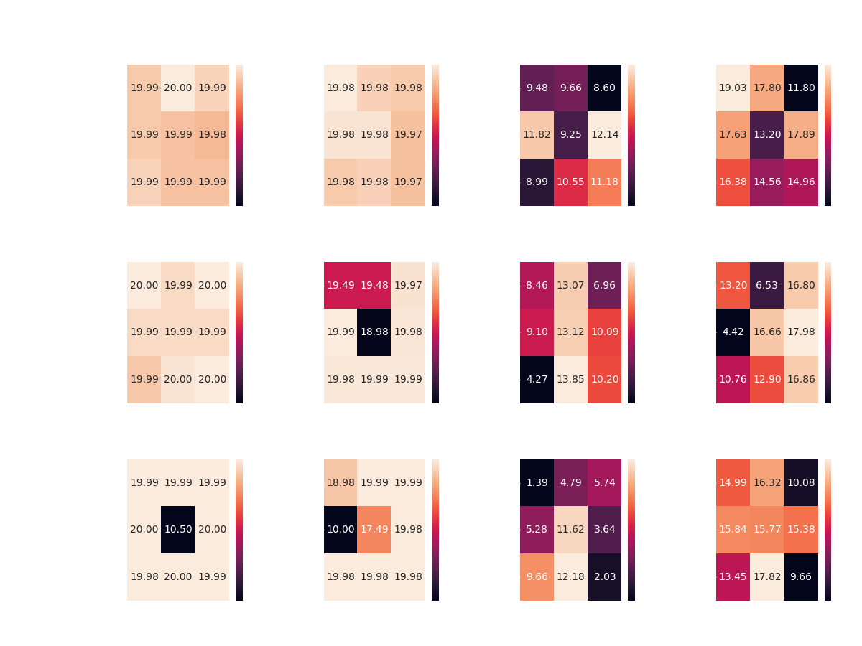
choosing optimal parameters
DDQN agent vs. Single Action Agent
Board of 10x10
Max reward of 20, by the fixed parameter of “Zombies per Game”

Slide 40
choosing optimal parameters
DDQN vs. all Simple Agents – board of 10x10:

Slide 41
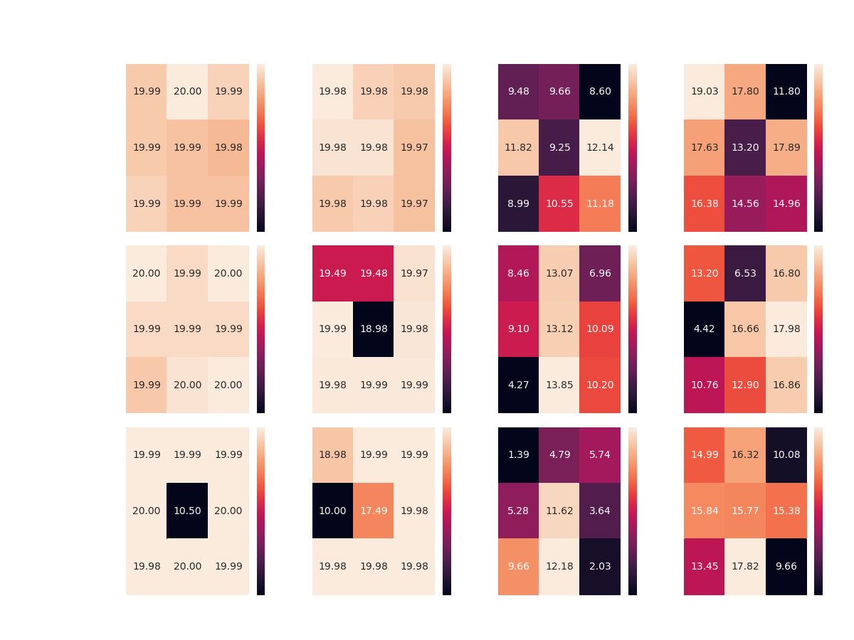

Slide 42
Results Discussion
Overall, it seems that the DDQN agent manages to overcome its competitors in most of the scenarios:
Achieving optimal reward competing Single and Double Action Agents with most of the configurations, on top all boards
Achieving 17+ average reward competing the Gaussian Agent on all boards, without achieving optimal reward in any scenario
However, the DDQN agent seems to encounter difficulties when faced with the Uniform Agent – managing to achieve average reward of 12-14

Slide 43
Results Discussion
While Competing against both the Random Agents, the DDQN Agent gets approximately same average reward over all three boards
Perhaps more learning episodes would make a change here?
Keep in mind that the highest reward against the Uniform Agent as light player is 15 – calculated by an agent which picks the best action exclusively (places zombies at the first row)
To settle the issue, I ran multiple scenarios of the same configuration, DDQN Agent vs. Uniform Agent, this time with 1800 learning episodes and 200 test episodes – all cases yield to the same average test reward of around 12

Slide 44
DDQN plays zombie - Best configurations*
Board size | Competitor | Memory Size | Target Update | Average Test Reward
10x10 | Single Action | 3000 | 750 | 20
 | Double Action | 3000 | 500 | 19.98
 | Uniform | 4000 | 1000 | 12.14
 | Gaussian | 3000 | 500 | 19.03
20x20 | Single Action | 3000 | 500 | 20
 | Double Action | 4000 | 500 | 19.99
 | Uniform | 5000 | 750 | 13.85
 | Gaussian | 4000 | 1000 | 17.98
30x30 | Single Action | 5000 | 750 | 20
 | Double Action | 3000 | 1000 | 19.99
 | Uniform | 5000 | 750 | 12.18
 | Gaussian | 5000 | 750 | 17.82

Slide 45
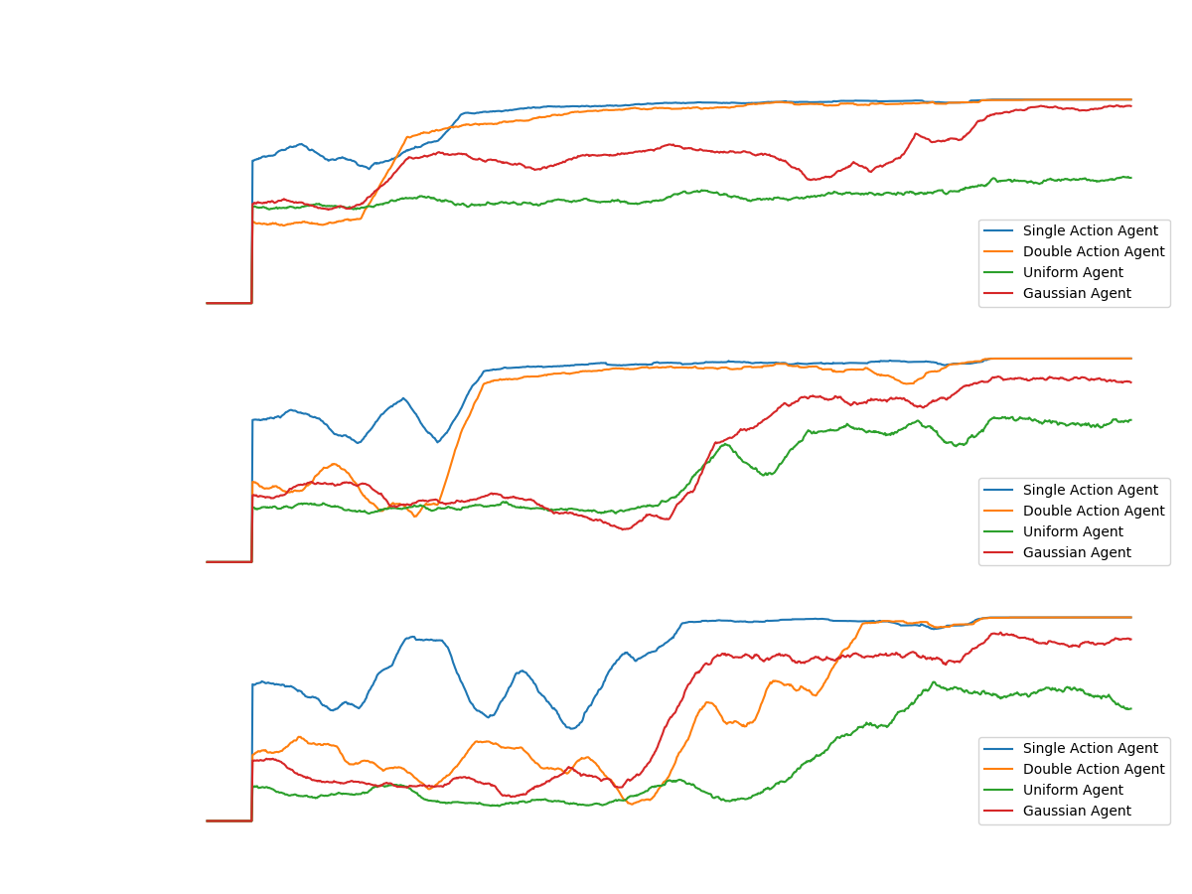
Notes:
note that in the case where the algorithm plays the zombie, the reward is positive
In general it can be noticed that there is learning against all the agents in all the games.
There is absolute success (convergence to optimal policy) against the constant agents
On the other hand, in games against the random agents, there is partial success but a significant upward trend in almost all cases.
In all cases except against the random agent in the game in the smallest board.
Because at this stage we have not examined the results in relation to any optimal method, we can not say if these are the best results the agent could achieve, but these are good and satisfactory results - there is general learning in all board sizes and against all agents

Slide 46
DDQN as the light player
Goal – Maximize Total Reward – Minimize Zombies Survive

Slide 47
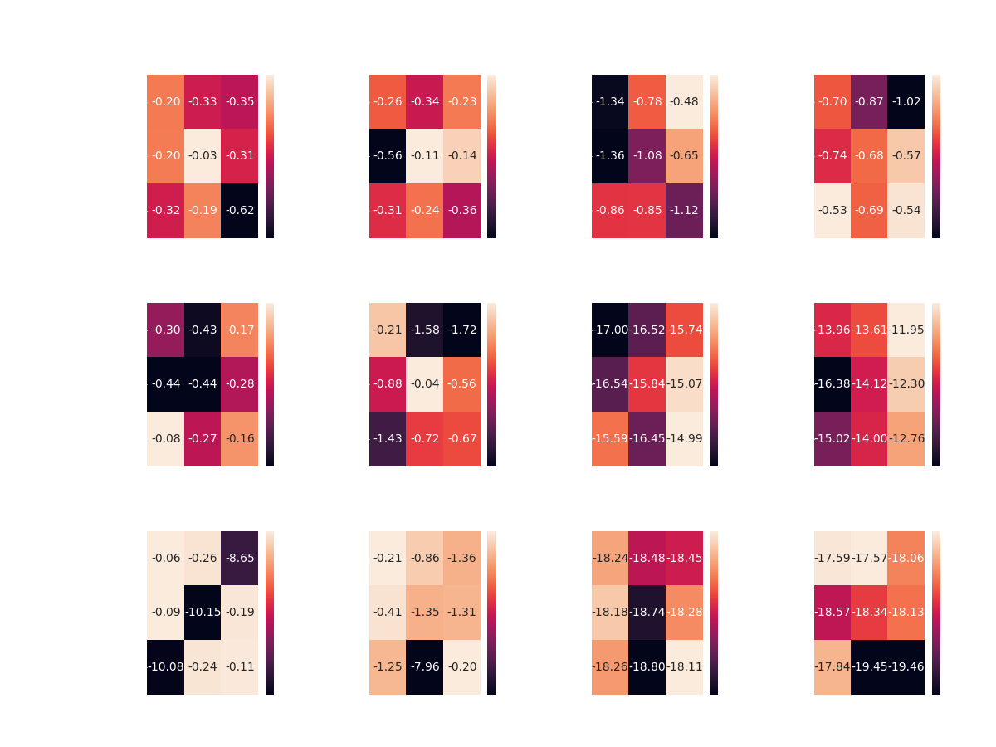
DDQN agent vs. Single action agent
Board of 10x10
Get negative rewards as the opposite of Zombie Player

Slide 48
DDQN vs. all – board of 10x10

Slide 49
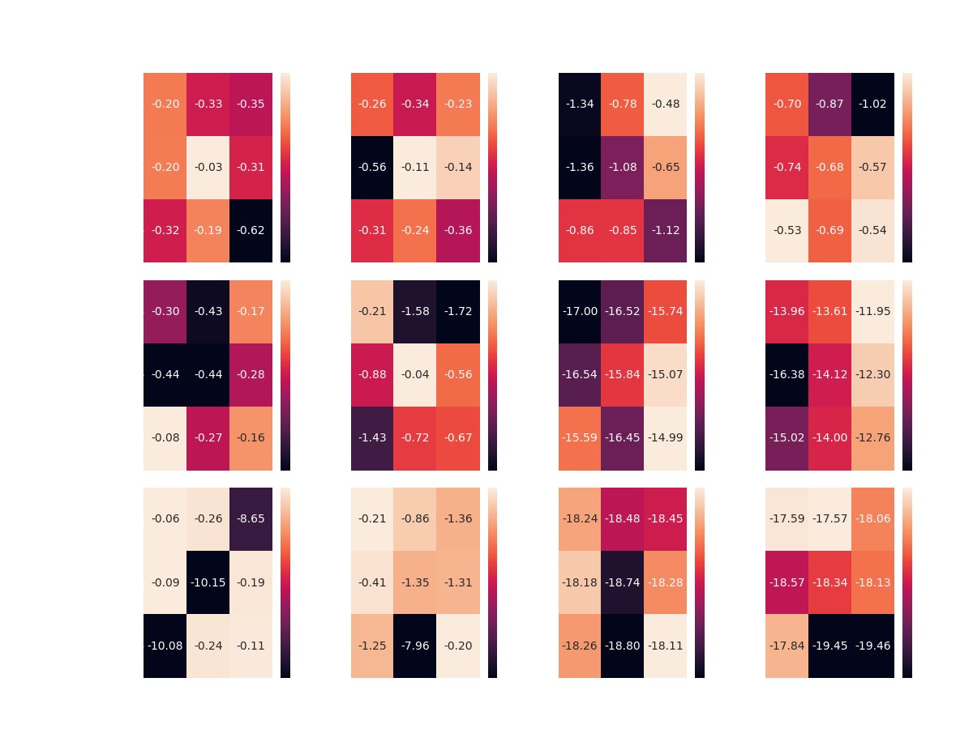

Slide 50
Results Discussion
This time the DDQN Agent managed to achieve partial success.
Over all boards, the DDQN Agent seems to overcome the two Constant Agents
With some preference of the [750, 4000] configuration in half of the cases
However, competing the Random Agents didn’t lead to same success
The DDQN Agent was able to reach optimality only in the case of the smallest board
This time, without any preference of any specific configuration

Slide 51
DDQN plays light - Best configurations
 | Competitor | Memory size | Target update | Average Test Reward
Board 10x10 | Single Action | 4000 | 750 | 0.03-
 | Double Action | 4000 | 750 | 0.11-
 | Uniform | 3000 | 1000 | 0.48-
 | Gaussian | 5000 | 500 | 0.53-
Board 20x20 | Single Action | 5000 | 500 | 0.08-
 | Double Action | 4000 | 750 | 0.04-
 | Uniform | 5000 | 1000 | 14.99-
 | Gaussian | 3000 | 1000 | 11.94-
Board 30x30 | Single Action | 3000 | 500 | 0.06-
 | Double Action | 5000 | 1000 | 0.2-
 | Uniform | 5000 | 1000 | 18.11-
 | Gaussian | 3000 | 750 | 17.57-

Slide 52
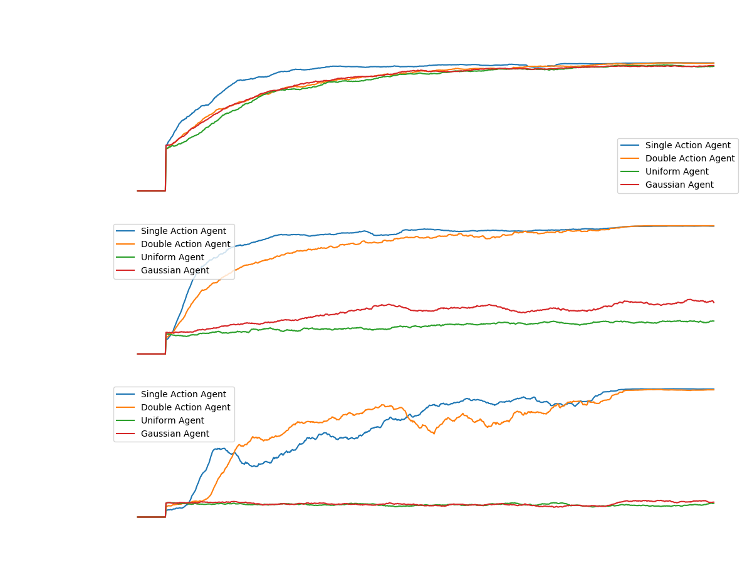
Notes:
note that in the case where the algorithm plays the light, the reward is negative
We can see a beautiful convergence to optimal policy against all agents on a 10x10 board.
However, when looking at the success of the light player as the DDQN agent in larger board sizes, one can see controversial success.
There is a convergence in all cases in the game against the constant agents.
But, if we look at the game against the random agents, we can see a relatively upward trend in the game against the middle Gaussian agent.
And in the rest of the games: A complete failure - there is not even a spark of convergence.

Slide 53
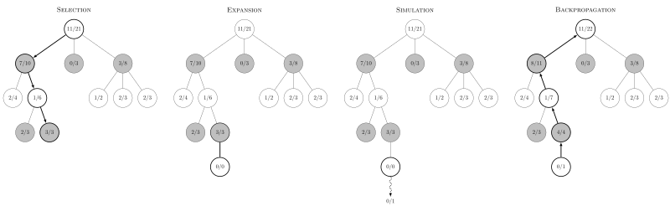
Monte Carlo tree search (MCTS)
Each iteration of the algorithm consists of 4 steps:

Slide 54
Monte Carlo tree search (MCTS) - results
We taught the MCTS agent to play against one of the simple agents. The agent reached an equilibrium in games it played as the zombie agent, against the simple and DDQN agent as well.
As the Light Player, each learning scenario kept fail duo to the 16 RAM constraint of the machine. It prevented us from playing on any reasonable size of board. The main reason of that is that the action space the light agent has is the number of expanded children each node has.
Therefore, we decided to proceed with our research and leave the MCTS implementation behind, meaning, we won't use it for in the following research.

Slide 55
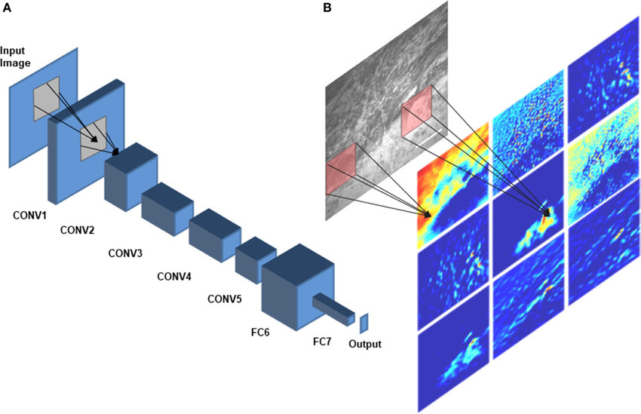

Alpha-zero
In 2016, Google DeepMind created a big stir when its computer program “AlphaGo” defeated reigning Go world champion Lee Sedol
Alpha-Zero is a generalization of AlphaGo outside the game of Go
There are 3 key components in Alpha-Zero:
Deep convolutional neural network
Monte-Carlo Tree Search
Competitive neural network evaluation

Slide 56
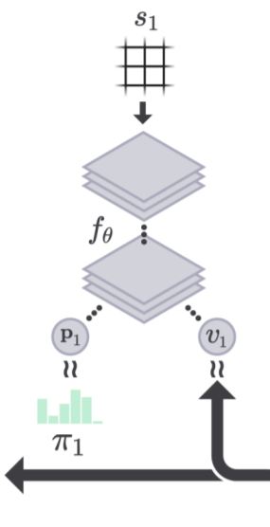
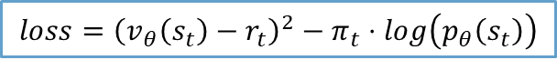
alpha zero - training
LIGHT
ZOMBIE
1. State
1. State
2. Actions
Cross Entropy
$$loss={\left(v_{θ}\left(s_{t}\right)−r_{t}\right)}^{2}−π_{t}⋅log\left(p_{θ}\left(s_{t}\right)\right)$$
Residual Squared
3. Reward

Slide 57
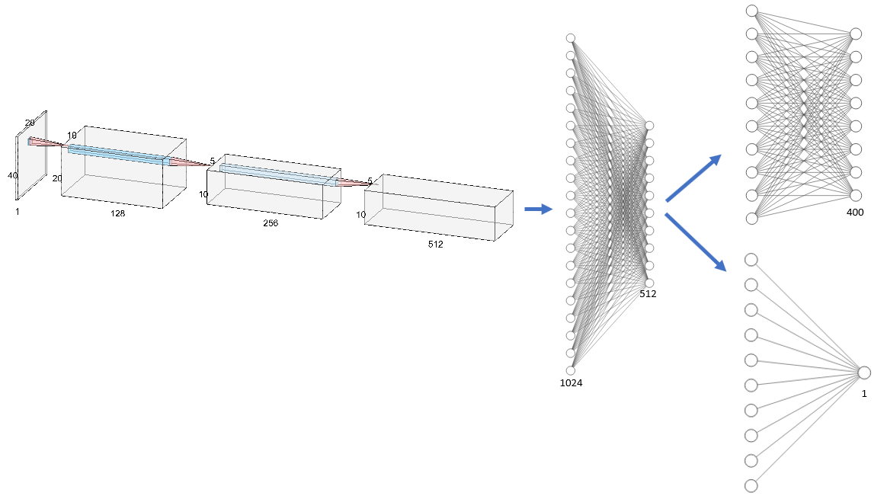
Alpha zero – our network
We were able to train a 3-layer CNN network followed by two fully connected layers:
================================================================= Layer (type:depth-idx) Param # ================================================================= ├─Conv2d: 1-1 1,280 = 128x(3x3+1) ├─MaxPool2d: 1-2 -- ├─BatchNorm2d: 1-3 256 ├─Conv2d: 1-4 295,168 = (128x3x3+1)x256 ├─MaxPool2d: 1-5 -- ├─BatchNorm2d: 1-6 512 ├─Conv2d: 1-7 1,180,160 = (256x3x3+1)x512 ├─BatchNorm2d: 1-8 1,024 ├─Linear: 1-9 5,243,904 = 1024x(1+512x(3x3+1)) ├─BatchNorm1d: 1-10 512 ├─Linear: 1-11 32,896 = 256x(128 +1) ├─BatchNorm1d: 1-12 256 ├─Linear: 1-13 12,900 ├─Linear: 1-14 129 ================================================================= Total params: 6,768,997 Trainable params: 6,768,997 Non-trainable params: 0 =================================================================

Slide 58
Alpha Zero as the Zombie player
Goal – Minimize Total Reward – Maximize Zombies Survive

Slide 59
game scenarios
Zombie Player | Light Player | Game Board
Single Action | AlphaZero | 10x10
Double Action
Uniform
Gaussian
Single Action | AlphaZero | 20x20
Double Action
Uniform
Gaussian
Single Action | AlphaZero | 30x30
Double Action
Uniform
Gaussian
Zombie Player | Light Player | Game Board
DDQN | Single Action | AlphaZero
 | Double Action
 | Uniform
 | Gaussian
DDQN | Single Action | AlphaZero
 | Double Action
 | Uniform
 | Gaussian
DDQN | Single Action | AlphaZero
 | Double Action
 | Uniform
 | Gaussian

Slide 60
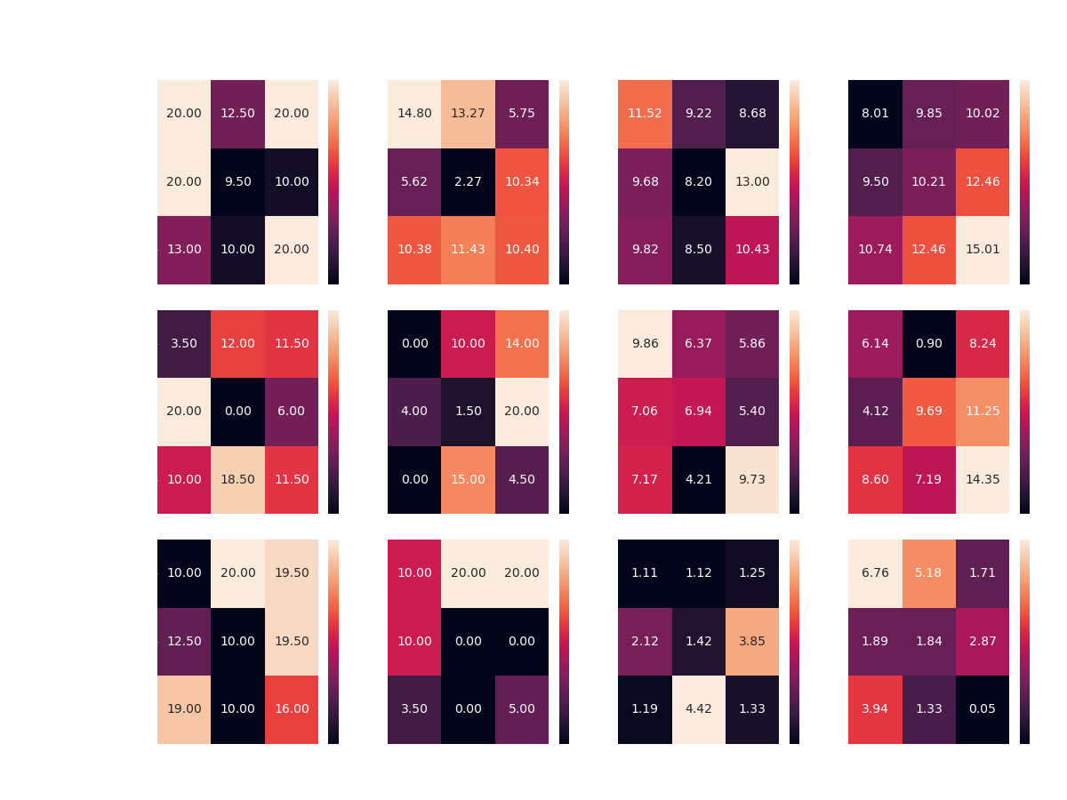

Slide 61
Alpha zero – results discussion
Unsurprisingly the AlphaZero agent manages to find a way to beat the simple agents in any board configuration
In contrast to the simple cases, the agent had difficulties producing a good strategy (compared to DDQN) against the random agents
In addition, it is apparent that there is a high variability in the agent's performance across the various configurations, unlike DDQN

Slide 62
Alpha zero plays zombie - Best configurations*
Board size | Competitor | Monte Carlo Searches | Exploration Rate | Average Test Reward
10x10 | Single Action | 5 | 0.5 | 20
 | Double Action | 5 | 0.5 | 14.8
 | Uniform | 10 | 1.5 | 13
 | Gaussian | 15 | 1.5 | 15
20x20 | Single Action | 10 | 0.5 | 20
 | Double Action | 10 | 1.5 | 20
 | Uniform | 5 | 0.5 | 9.86
 | Gaussian | 15 | 1.5 | 14.34
30x30 | Single Action | 5 | 1 | 20
 | Double Action | 5 | 1 | 20
 | Uniform | 15 | 1 | 4.42
 | Gaussian | 5 | 0.5 | 6.76
Notes:
Lowest possible searches with single and double compared to high values with uniform and gaussian (20x20 uniform agent with similar results is with 15 searches as well)

Slide 63
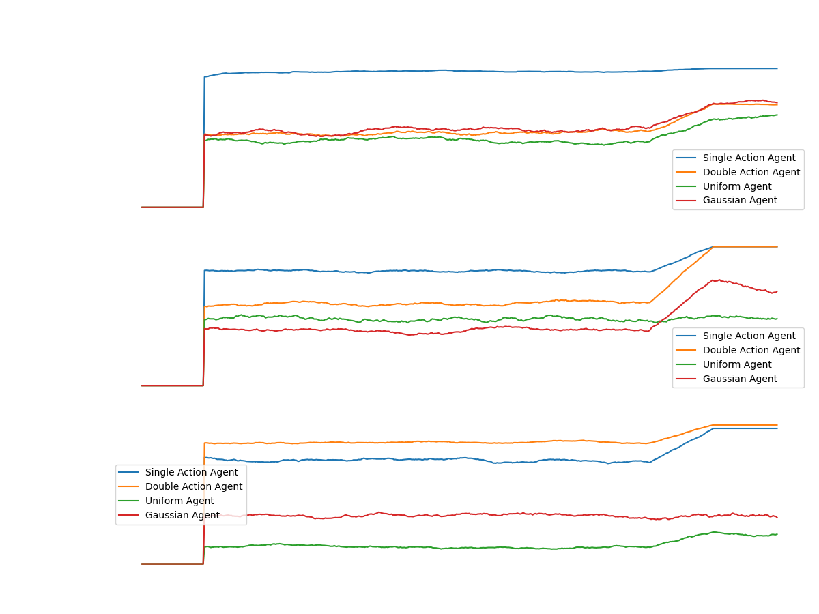
Notes:
From the graph above, it seems that in cases where the agent fails to converge to successful strategy (compared to DDQN), there is a learning barrier at the beginning of the process
This barrier could be due to a poor configuration of the AlphaZero algorithm. As well as the partial observability compared to the success the agent reaches as the Light Player (next section).

Slide 64
Alpha zero as the light player
Goal – Maximize Total Reward – Minimize Zombies survive

Slide 65
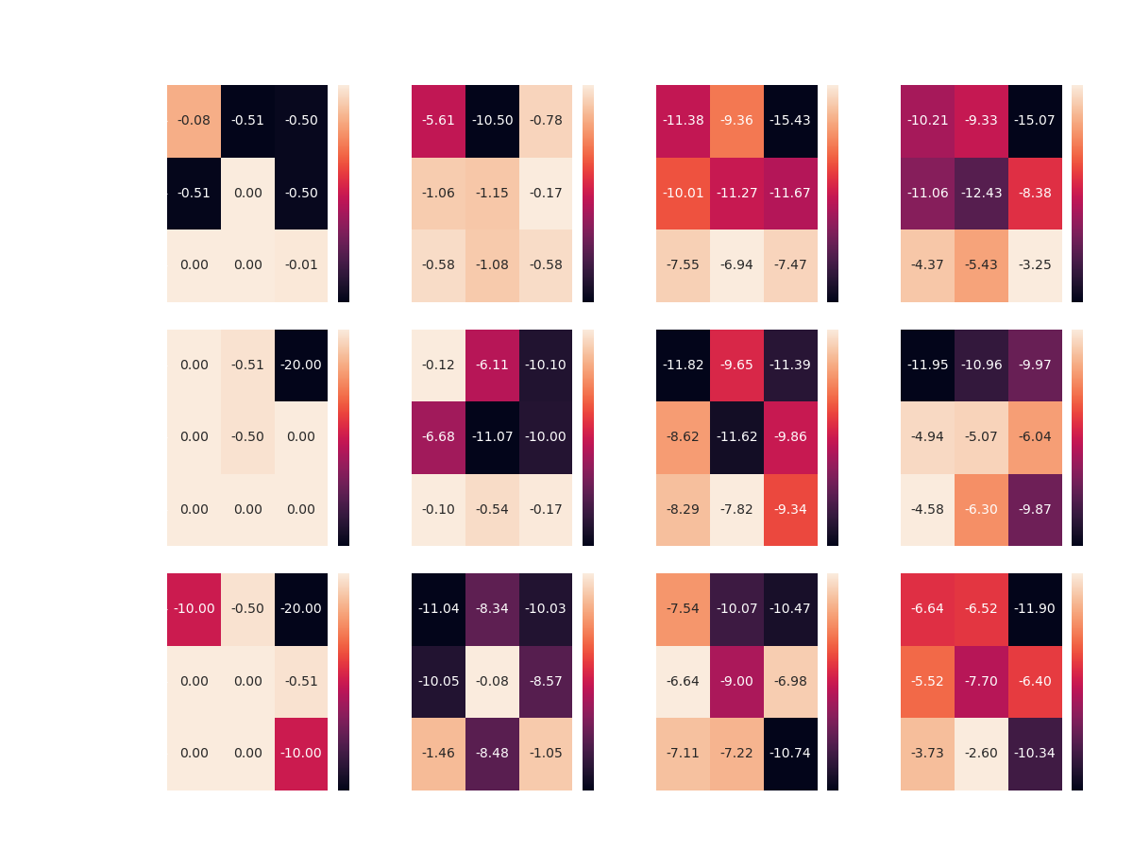

Slide 66
Alpha zero – results discussion
The agent produces an optimal strategy against the simple agents
In addition, in an unprecedented way so far in the project, the agent manages to come up with a successful strategy against the random agents
In both games with the 20 and 30 square boards, the agent surpassed the DDQN agent so that in the game against the Gaussian agent he gained almost the maximum possible reward

Slide 67
Alpha zero plays zombie - Best configurations*
Board size | Competitor | Monte Carlo searches | Exploration rate | Average Test Reward
10x10 | Single Action | 15 | 0.5 | 0
 | Double Action | 10 | 1.5 | -0.17
 | Uniform | 15 | 1 | -6.94
 | Gaussian | 15 | 1.5 | -3.25
20x20 | Single Action | 5 | 0.5 | 0
 | Double Action | 15 | 0.5 | -0.1
 | Uniform | 15 | 1 | -7.82
 | Gaussian | 15 | 0.5 | -4.58
30x30 | Single Action | 10 | 0.5 | 0
 | Double Action | 10 | 1 | -0.08
 | Uniform | 10 | 0.5 | -6.64
 | Gaussian | 15 | 1 | -2.6
Notes:
As the light player, we notice that the algorithm performs well with the greater amounts of tree searches, which it is reasonable since the light player action space is larger (exponential greater compared to zombie player)

Slide 68
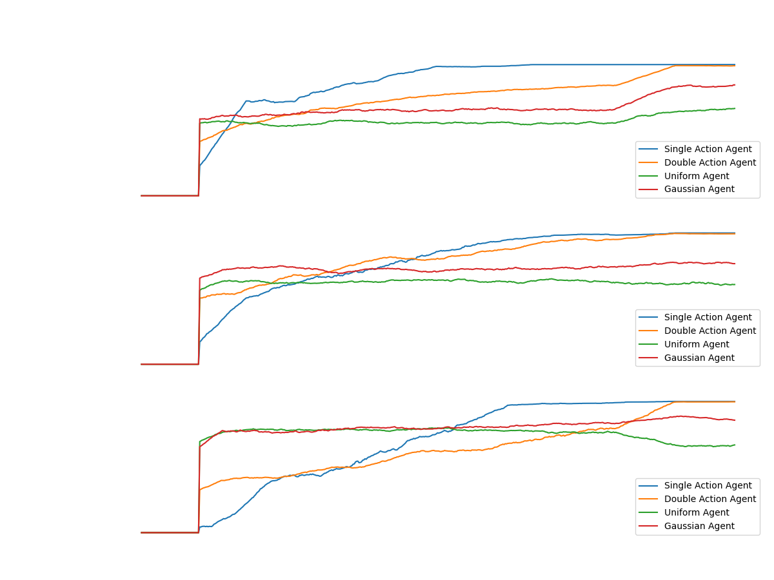
Notes:
The most striking thing that catches our eyes in games against the random agents, is the fact that AlphaZero agent quickly converged into a strategy unlike those against the simple agents.
The main reason for such cases is the fact that the algorithm is based on the Monte Carlo Tree. Which updates the State-Action values ​​according to the rewards from the environment.
In games against the simple agents, AlphaZero agent spends most of the time looking for actions which will reward him positively and finds this only in a very limited number of situations, since the zombies travel in unique places over the board

Slide 69
alpha-zero and DDQN Competition

Slide 70
Towards Competing alpha-zero vs. DDQN
Competing AlphaZero and DDQN requires the best of each model on every game board
The agents learned and converged to optimal strategies with different sets of parameters in each game board
How do we decide which set of parameters will perform best against another learning agent?

Slide 71
Towards Competing alpha zero vs. DDQN
Let’s take DDQN for example
The most difficult agent we trained it against is the Uniform agent
We took the DDQN agent that learned to play against the uniform agent and evaluated it against the rest of simple agents (Single, Double, Gaussian)
The agent perform significantly better against the Gaussian agent in contrast to Single/Double agents
 | Board Size | Model | Single | Double | Gaussian
As light | 10x10 | DDQN | 1 | 1 | 1
 | 20x20 | DDQN | 1 | 1 | 1
 | 30x30 | DDQN | 0 | 0 | 0
As zombie | 10x10 | DDQN | 0 | 0 | 1
 | 20x20 | DDQN | 0 | 0 | 1
 | 30x30 | DDQN | 0 | 0 | 1
Notes:
This is because the best model was trained against the Uniform agent which is very similar to the Gaussian agent

Slide 72
Constructing the composite agent
The original idea that stands behind preparing the learning agents for battle, hasn't led to any success
Therefore, we had to take another approach in order to generify the agent strategy and its total potential against other unknown agents
For that effort, we built a new agent called 'Composite Agent' that is the combination of all simple agents

Slide 73
the composite agent
Its' strategy set to imitate one of the four simple agents at a time, for full episode period:
The agent learns from data samples generated from constant AND random agents, all at the same train process.
The expectation: the Composite-Agent's strategy would out-perform each of the simple agents, separately
Single Action Agent
Double Action Agent
Gaussian Agent
Uniform Agent
Notes:
Lowest possible searches with single and double compared to high values with uniform and gaussian (20x20 uniform agent with similar results is with 15 searches as well)

Slide 74
the composite agent – final evaluation
DDQN trained with the Composite agent, results:
AlphaZero trained with the Composite agent, results:
 | Board Size | Model | Single | Double | Gaussian | Uniform
As light | 10x10 | DDQN | 1 | 1 | 1 | 1
 | 20x20 | DDQN | 1 | 1 | 1 | 1
 | 30x30 | DDQN | 0 | 0 | 1 | 1
As zombie | 10x10 | DDQN | 1 | 1 | 1 | 1
 | 20x20 | DDQN | 1 | 1 | 1 | 0
 | 30x30 | DDQN | 0 | 0 | 1 | 0
 | Board Size | Model | SingleAction | DoubleAction | Gaussian | Uniform
As light | 10x10 | AlphaZero | 1 | 0 | 0 | 0
 | 20x20 | AlphaZero | 0 | 0 | 1 | 1
 | 30x30 | AlphaZero | 0 | 1 | 1 | 1
As zombie | 10x10 | AlphaZero | 0 | 0 | 1 | 1
 | 20x20 | AlphaZero | 1 | 0 | 1 | 1
 | 30x30 | AlphaZero | 1 | 0 | 0 | 0

Slide 75
The competition – results
The DDQN and AlphaZero agents played both as the zombie and light player, in every game board (squared boards of 10, 20, 30)
In all competition scenarios the DDQN algorithm managed to overcome or substantially defeat AlphaZero
Not intuitive results - explained by:
The massive amount of AlphaZero parameters in comparison to DDQN
The insufficient number of episodes we ran to train AlphaZero due to slower training compared to DDQN (60 times slower)
Notes:
This is because the best model was trained against the Uniform agent which is very similar to the Gaussian agent

Slide 76
Project summary
We built a suitable environment for training and evaluating learning agents
We implemented the algorithms Double Deep Q-Learning, Monte-Carlo Tree Search and Alpha Zero to play the game of ‘Light against Zombies’
We were able to reach convergence and competition with the learning algorithms
Although the results we obtained are not intuitive, we are satisfied and completed the purpose of the project, since all the agents we implemented showed a positive and significant learning curves

Slide 77
Next steps – further research
Broad parameter tuning would produce improved results:
Examine different network architectures for DDQN and AlphaZero
Hyper parameter tuning of each algorithm parameters
Parallel and cost-effective implementation of the Monte-Carlo-Tree-Search algorithm
Provides comparability to other learning algorithms (At evaluation and competition)
Faster learning of AlphaZero agent – more episodes would have led to improved results
Notes:
We will expand on additional directions for further research, given additional time and computing resources (RAM and processing units)

Slide 78

Thanks!
Any Questions?

